Slide 1




HIV Prevention, Treatment and Care in Prisons and other Closed Settings
ICASA 2015
Harare, Zimbabwe
2 December 2015
Ehab Salah
Prisons and HIV Advisor
UNODC, Vienna

Slide 2

UNODC and Prisons
UNODC, a co-sponsor of UNAIDS, Convening agency on HIV prevention, treatment and care for:
  people who use drugs
  People in prisons and other closed settings
UNODC promotes
  Criminal Justice reform
  Prison reform
  Drug treatment and rehabilitation in prisons
  HIV prevention, treatment and care in prisons

Slide 3
HIV and Prisons: Facts and Figures
30 million people in prisons and other closed settings every year
HIV prevalence in prison, always higher than in the community and can be very high
TB and AIDS are major causes of mortality in prisons

Slide 4
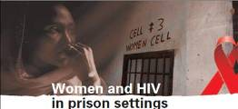
Women and HIV in Prisons
Women represent 5 to 10 % of the total prison population
The female prison population has risen in all continents
Higher HIV prevalence rates among women in prisons

Slide 5
HIV prevalence in Prisons: Gender
Notes:
In Lesotho: The female prisoners sample was too small for any measurement of significance; it was concerning, however, that 9 of 13 female inmate respondents were HIV-positive.

Slide 6
HIV and TB in prisons: contributing factors
Over-representation of key populations for HIV
All modes of transmission occurring in the community, occur in prison: blood transmission, sexual transmission (consensual, forced) and vertical transmission
Poor prison conditions: overcrowding, malnutrition, poor ventilation, poor natural light, hygiene
Poor prison management: violence, gangs, poor classification
Low access to preventive, curative, reproductive and palliative care and lack of continuity of treatments
Isolation of health services from public health programmes
Stigma, neglect and denial.

Slide 7
Prison Incarceration rates per 100,000 in Africa
Notes:
http://www.prisonstudies.org/highest-to-lowest/prison_population_rate?field_region_taxonomy_tid=15

Slide 8
Prison Occupancy Rates (%) in Africa
Notes:
Prison occupancy rates are based on the official capacities
http://www.prisonstudies.org/highest-to-lowest/occupancy-level?field_region_taxonomy_tid=15

Slide 9
% of Pre-Trial detainees / remand prisoners in Africa
Notes:
http://www.prisonstudies.org/highest-to-lowest/pre-trial-detainees?field_region_taxonomy_tid=15

Slide 10

Gaps in HIV services in prisons
  Health care in prison settings is typically limited and not equivalent to those provided in the community
  Lack of continuity of care
  Health care in prisons is often provided by the ministry responsible for prison
  Mandatory HIV testing and lack of confidentiality
  Absence of or limited harm reduction programmes in prisons especially condoms, opioid substitution therapy (OST) and the needle and syringe programme (NSP)

Slide 11
Global Commitment to Uphold the Rights of People Living in Prisons
  The revised UN Standard Minimum Rules for the treatment of Prisoners (the Nelson Mandela Rules)
  Political Declaration on HIV and AIDS: Intensifying our Efforts to Eliminate HIV and AIDS
  The Rules for the Treatment of Women Prisoners and Non-custodial Measures for Women Offenders (the Bangkok Rules)

Slide 12


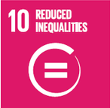


2030 Agenda for Sustainable Development
to end AIDS, TB and combat hepatitis and other communicable diseases
aim to achieve universal health coverage
empowering all women and girls, including those in prisons and closed settings
reduction of inequalities, the elimination of discriminatory laws and policies
the promotion of social protection policies
Promote the rule of law to ensure equal access to justice for all, develop effective, accountable, and transparent institutions at all levels
protect fundamental freedoms, and promote and enforce non-discriminatory laws and policies.
Teaming with communities and other partners to end the AIDS epidemic by 2030

Slide 13
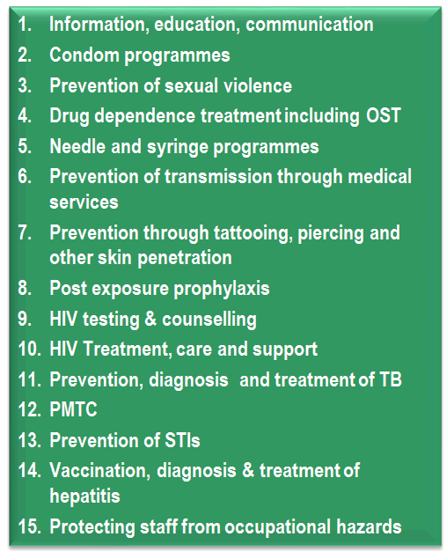
UNODC’s Support to Countries
UNODC, ILO, UNDP, WHO and UNAIDS
The Comprehensive Package: 15 Key Interventions
Normative guidance on HIV in prisons
Advocacy to promote human rights-based, gender responsive and evidence-based approaches
Support to review, adapt, develop and implement effective legislation, policies and strategies including on alternative to imprisonment
Building capacities of government agencies, CSOs and other national partners

Slide 14

A Way Forward
To end the AIDS epidemic by 2030, leaving no one behind including people living in prisons the following strategies are critical. We need
To extend evidence-informed, rights-based, age and gender-responsive HIV prevention treatment and care measures to all people in prisons and other closed settings
2. To improve quality and increase coverage of comprehensive HIV services
3. To take joint action to develop and implement criminal justice reform programmes including alternatives to incarceration
4. To align efforts to develop and implement prison reform initiatives including improving the working and living conditions
5. To institute stronger accountability and improved availability of strategic information to guide policies, strategies and actions

Slide 15

Thank You!
@UNODC_HIV

