Slide 1
Improving access and innovation in hiv through voluntary licensing: the experience of the Medicines Patent Pool
ICASA – Harare, Zimbabwe
Session on Innovation in service delivery
Esteban Burrone

Slide 2
What is the Medicines patent pool?

Slide 3
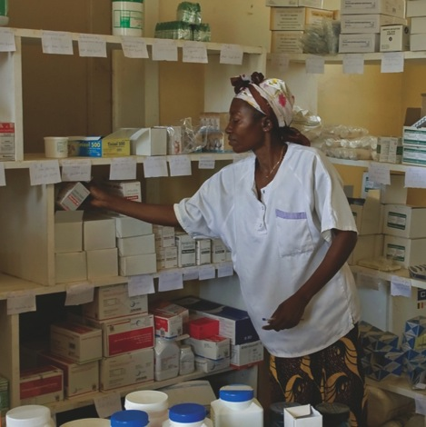
The Medicines Patent Pool
Established with the support of UNITAID in 2010 to improve access to appropriate, affordable HIV medicines in LMICs through voluntary licensing and patent pooling
Endorsed by international community (UN General Assembly) as a mechanism to enhance innovation and access
Licences negotiated from public health perspective to enable affordable access to medicines for the highest possible number of PLHIV in developing countries
In addition to accelerating access to affordable ARVs, the MPP seeks to facilitate the development of fixed dose combinations (FDCs) and paediatric formulations.

Slide 4




THE MODEL
PATENT HOLDERS
GENERIC MANUFACTURERS
PEOPLE LIVING WITH HIV
Sub-
Licences
Licences
Medicines
ROYALTIES
Established and fully funded by

Slide 5
What challenges was it trying to address

Slide 6
INCREASE IN PATENTING OF ARVS IN LOW AND
MIDDLE INCOME COUNTRIES
Source: Medicines Patent Pool Database

Slide 7




Challenges with fixed dose combinations (including paediatric formulations)
Patented by A
Patents on a full HIV treatment can be held by different patent holders making it difficult to develop a pill that brings together various active ingredients
Licensing can be a way to address this challenge by pooling all patents needed for developing more affordable combination pills

Patented by B
Patented by C
Patented, but
licensed to MPP
Patented, but
licensed to MPP
Patented, but
licensed to MPP

Slide 8
Long lag for market entry of generics
Time from approval of new HIV medicines to availability of quality assured generics for developing countries has generally been between 5 to 10 years
Timeline From Originator Approval to Generic Availability:
Originator Approval
Generic Approvals
0 | 1 | 2 | 3 | 4 | 5 | 6 | 7 | 8 | 9 | 10
Years
Notes:
Historically, it has taken an average of 7 – 9 years for generic versions of new HIV treatment to reach LICs after FDA/EMA approval

Slide 9
Missing paediatric formulations
“Missing paediatric formulations” has impacted ability to scale up paediatric treatment with the most efficacious ARVs in formulations suited for all age groups
Illustration of formulation challenges with certain paediatric ARVs:
  Not available in formulations suitable for youngest
  Only available as syrup
  Palatability issues
  Not available in single dosage form
  High alcohol content
  Price

Slide 10
Progress and achievements 2010-2015

Slide 11

MPP PROGRESS TO DATE
Partnerships with 9 patent holders and 7 licensing agreements
117 countries receiving first-line ARVs from MPP generic partners
14 generic manufacturers working with the MPP
US$ 119.6m saved: equivalent to 1-year of treatment for approx. 1 million people
12 antiretrovirals (ARVs) licensed to the MPP
New adult formulations and paediatric formulations under development
Over 50 sub-licences with generic manufacturers
Projected savings of at least $ 1.4 billion (not counting health systems savings)

Slide 12
Licences to Date

Slide 13
Geographical COVERAGE
* Based on specific provisions in the licences and information from the MPP Patent Status Database
** Based on data from UNAIDS

Slide 14
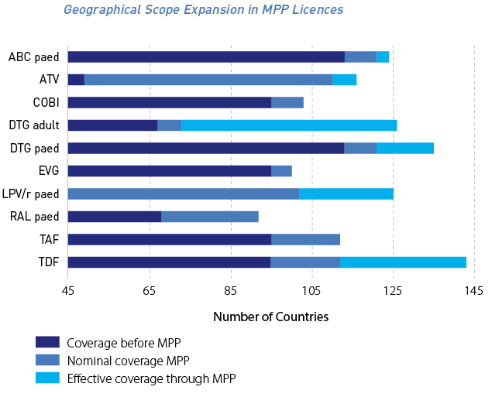
Geographical scope expansion in MPP HIV licences

Slide 15
Terms and conditions in MPP licences
Licensing Terms | Prior to MPP | With MPP
Publication of agreements | No publication | All agreements public
Number and selection of licensees | Arbitrary, sometimes limited | Open, non-exclusive, non-discriminatory, regular monitoring
Sales outside territory | Limitations; details unknown | Can sell in case of compulsory licences; provisions that allow sale in other circumstances enabling more countries to benefit
Possibility to make FDCs and paediatrics | Details unknown | Freedom to make suitable FDCs and paediatric formulations
Freedom to challenge patents | Limitations in some; details unknown | In all agreements
Waivers of data exclusivity | Unknown | In all agreements
Making and selling active pharmaceutical ingredient | Limitations; Details unknown | In all agreement can make and sell API to other licensees
Quality assurance | Unknown | All agreements require WHO PQ or SRA approval

Slide 16




The Paediatric HIV Treatment Initiative
Launched in May 2014. A UNITAID-MPP-DNDi-CHAI initiative
Challenges:
Miss-match between medicines recommended by WHO for children and those being used on the ground
Challenges with many formulations, esp. for youngest
Mission:
Deliver the paediatric ARV formulations needed to meet the treatment targets for all children living with HIV in low & middle income countries by 2020
Vision: Building upon the expertise of the organisations, lead coordination of drug development & access activities by multiple stakeholders to bridge the gap between the need and operational delivery of Paediatric HIV treatment
Working through product specific teams to develop the formulations identified by the WHO

Slide 17
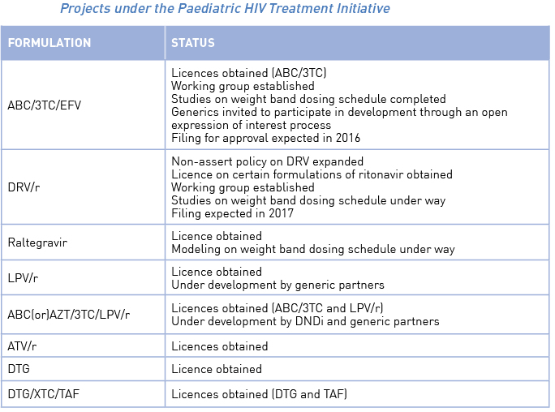
Projects under the Paediatric HIV Treatment Initiative (PHTI)

Slide 18
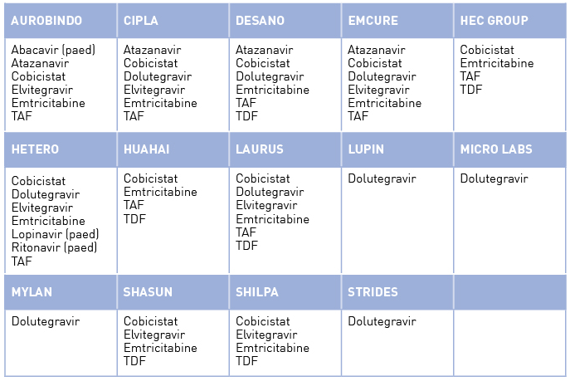
Sub-licensing with generic manufacturers to date

Slide 19
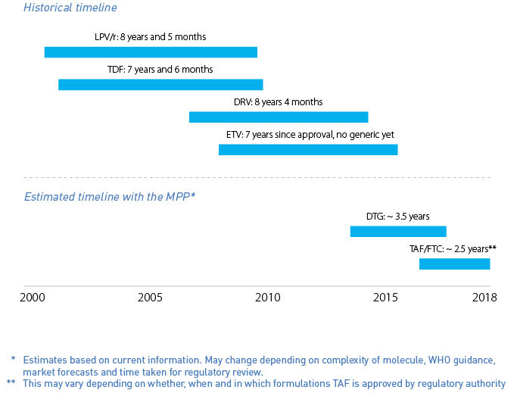
Speeding up development: Time from originator approval to TWO quality assured generics

Slide 20
THANK YOU
www.medicinespatentpool.org
@MedsPatentPool

