Slide 2
Children’s transfer from a Pediatric department to another: Its organization and challenges in a resource-limited setting
CHAFFA Raissa¹ , Dossou Dorette ² , Zanvo Doris² , LOGBO Parsifal¹ , Tcheho Therese² , Padonou Jijoho¹ , AZONDEKON Alain^{1,2}
¹University of Porto-Novo, Faculty of Medecine ,Porto-Novo ,Benin ²Military Teaching Hospital ,Pediatrics ,Cotonou ,Benin
Oral presentation -ICASA 18th session , Nov- 4th Dec-Harare(Zimbabwe) .

Slide 3
OUTLINES
INTRODUCTION
Objectives
Methods
Results
Summary
CONCLUSION

Slide 4
INTRODUCTION 1
Despite PMTCT we still having children infected by HIV
or some unknown as well
Need access to best care and follow up programs
Depending on their life conditions:
-social and economics conditions,
-quality of care
-coverage of health system

Slide 5
SITUATION IN BENIN
French West African country
Population : 10 million (2014)
45% children infected
Care package already available
- Need More ART Sites as near
as possible to population
-Ensuring acces and best quality
Of care
GHANA
NIGERIA

Slide 6
I.OBJECTIVES

Slide 7
GENERAL
Evaluate what is the best way to organize transfer ?
How to assure the continuum of treatment ?
SPECIFICS
What are the benefits and challenges we gain?
What are impacts for the health system and for children ?

Slide 8
WORKING ENVIRONMENT
MILITARY TEACHING HOSPITAL OF BENIN (Cotonou)
PEDIATRIC DEPARTMENT
CUCEIH(Care Unit for Children Exposed or Infected by HIV)

Slide 9
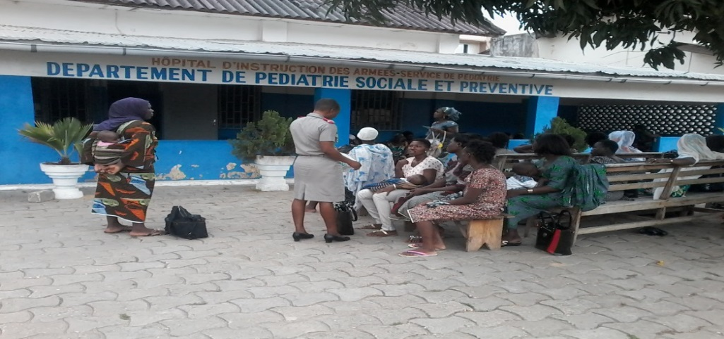
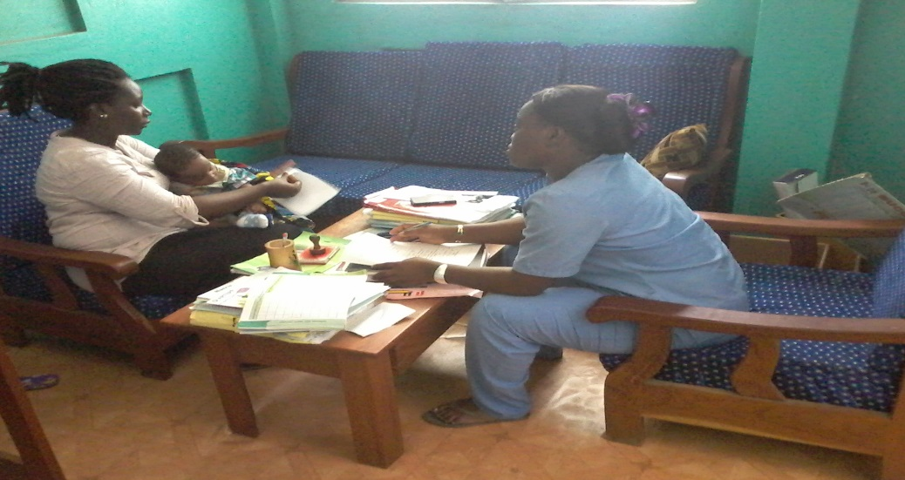
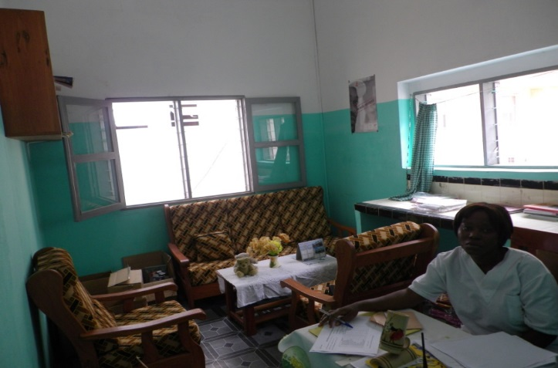
SOCIAL AND PREVENTIVE PEDIATRIC DEPARTMENT
SOCIAL WORKER OFFICE
HEALTH EDUCATOR

Slide 10
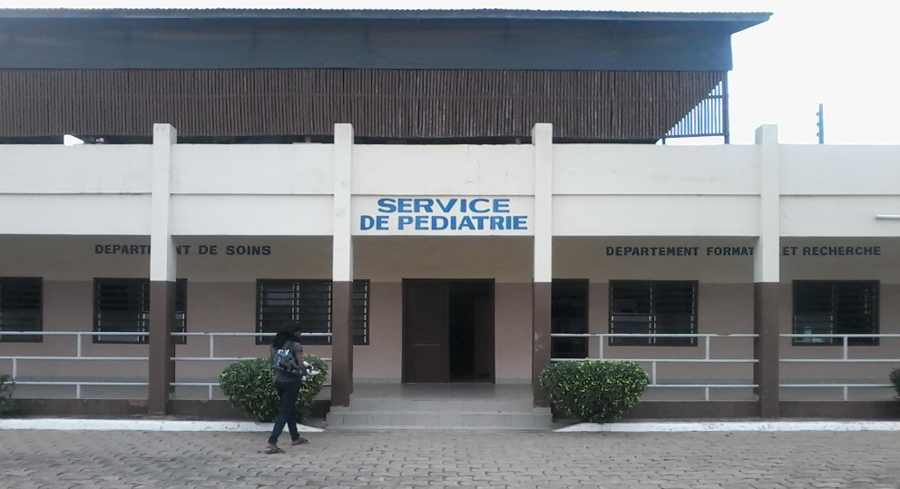
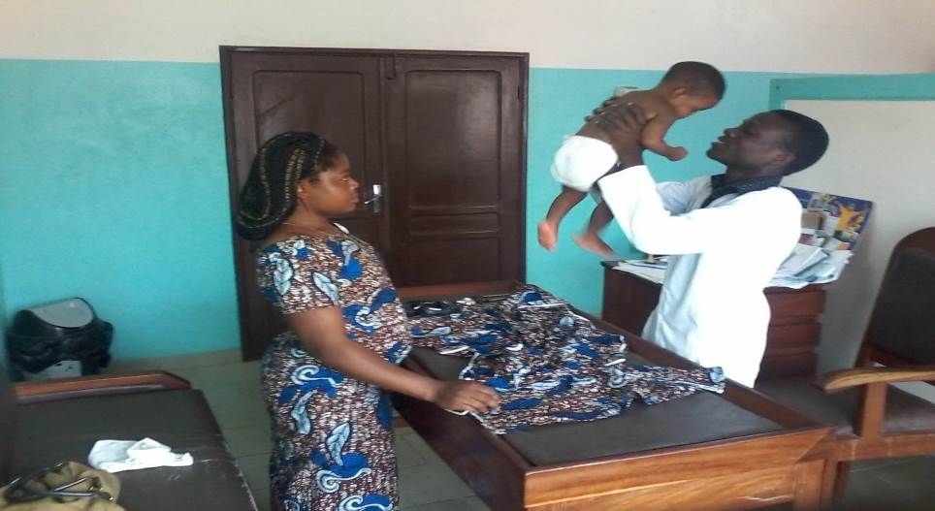
RESEARCH AND CARE DEPARTMENT
CONFERENCE ROOM
NUTRITIONAL SUPPORT
EXAMINATION ROOM

Slide 11
II. METHODS

Slide 12
PERIOD : 2010 -2014
DESCRIPTION
During 3months,children transferred from CUCEIH
to another center have been followed ( 1week- 1month-
3months) ,by Social worker
Transfer reason+ Files’s summary +responsible care giver contact
Transfer evidence made according to the genosociogram

Slide 13
SPECIALS CASES
Visit to child (Home or Hospital)
SOCIAL WORKER
unsatisfied Parents (coming back)
EXTENDING DELAY
One year if unsatisfactory conditions

Slide 14
IV. RESULTS

Slide 15
Children charachteristics
163 children has been transferred (good clinical state)
66% were orphans and
Age : 8months-14years
Medial was 4years
44 went with feedbacks
4 were unsatisfied and redirected to another center

Slide 16
Transfer’s reasons
Emplacement rapprochement (n=26)
Posting of person in charge of the child (n=7)
Departure for traditional cares (n=7)
Fear of status discovery (n=6)
Father’s death (n=5)

Slide 17
Transfer results
43 were under treatment,
7 preferred traditional care
ARV stopped but CTM continued
The 7 preferring traditional care came back
9months after : adherence to treatment was better

Slide 18
V. SUMMARY

Slide 19
Summary
(N) children infected
CONTINUUM OF TREATMENT
(X) children transferred
Involvement of Human and Social Sciences
Better care
given
Positifs impact
On Economic
Improvement of
Life conditions
(N-X) children
Better care
service
Better service
coverage

Slide 20
WHAT ARE PERSPECTIVES NOW?
Establish a real collaboration between care centers
Create More sites near to population Useful :
Assurance of a Universal coverage and acces to treatment
Positives impact on economics
Improvement of the Health System
Promote Social and Human Science

Slide 21
CONCLUSION

Slide 22
INFECTED CHILDREN ALREADY ON TREATMENT IN A CENTER
INCOMODIOUS CONDITIONS OF LIFE
DECISION TO TRANSFER
Involvement of
Human and Social
Sciences
Loss of follow up
No evidence of continuum of treatment
Sometimes worse health conditions and death
Fast tract 90-90-90
Better care,
Improvement of life conditions,
Better health condition
Continuum of care

Slide 23
ACKNOWLEGDMENT
Med Col Azondekon Alain
Mr Bognon Tanguy
Mr Akpoli Rock
Captain Dopkonou
All the Pediatric department’s team
To all those who contribute to this
Prof Padonou Jijoho
Logbo Parsifal
English pediatric class 2015

