Slide 1






Recalibrating the EID Cascade in Zimbabwe
True outcomes among a sample of HIV-exposed infants with no documented EID
Karen Webb¹, Vivian Chitiyo¹, Theresa Ndoro¹, Paul Nesara¹, Simukai Zizhou², Nyika Mahachi², Barbara Engelsmann¹, Elvin Geng³
¹Organisation for Public Health Interventions and Development Trust, Harare, Zimbabwe
²Ministry of Health and Child Care, Zimbabwe,
³University of California San Francisco, San Francisco, US
Session C/11: Towards eliminating mother to child transmission of HIV
ICASA 2015

Slide 2

Background: Early Infant Diagnosis (EID)
In absence of timely EID and treatment:
•1/3 of infants living with HIV die before 1st birthday
•1/2 die before age of two.¹
HIV tests for HIV-exposed infants recommended at 6 weeks after delivery (DNA PCR)²
  EID by 6 weeks among HIV-exposed infants estimated as low as 45%³
¹WHO/UNAIDS/UNICEF (2011) ‘ Global HIV/AIDS Response: Epidemic update and health sector progress towards Universal Access 2011).
²MOHCC (2014).Zimbabwe National Guidelines for HIV Testing and Counselling in Children and Adolescents.
³Zinyowera, S et al. The Zimbabwe HIV Early Infant Diagnosis (EID) Program for the period 2007-2012imbabwe Ministry of Health and Child Care.

Slide 3
Background: Documenting EID in Zimbabwe
Multiple paper-based registers = reporting individual outcomes over time laborious and error prone – timely EID not routinely reported
Evaluating individual outcomes across facilities is almost impossible
Challenges to collection of individual-level information over time on HIV-infected mother-HIV exposed baby pairs undermines our understanding of PMTCT program effectiveness
Notes:
Here is my suggested single slide for background
**I’m kind of really comfortable presenting the first two and can do it quickly as is compartmentalised in my mind – have mashed together your points with my second slide.

Slide 4
OBJECTIVES
Estimate proportion of mother-baby pairs in Mashonaland East Province with documented uptake of EID within 3 months of birth.
Trace randomly selected sample with no documented EID to determine whether they had HIV testing.
Establish reasons for no EID.
Notes:
EG:
Total population of women of child bearing age in Mashonaland East:
DONE - Replace establish with “estimate” in Mashonaland East Province – give total population to give people a sense of how big we are talking?
DONE - Trace a “randomly selected” of mother-baby pairs with no documented EID to find whether they had accessed HIV testing (true outcomes here is too broad) as well as reasons for failing to obtain EID for those women who did not
Get rid of map?

Slide 5

METHODS
Province-wide, multi-stage survey sampling approach:
Facility: Offering ANC care in Mashonaland East Province selected with probability proportional to size (45/193)
Documented EID: for HIV-exposed infants among all HIV infected women who accessed ANC services at selected sites from April 2012 – May 2013
Community tracing: random sample of HIV-infected women no documented EID
Notes:
We estimated the proportion of hiv exposed infants in Mashonaland East pairs who obtained EID in Mashonaland East using a province-wide survey sampling approach
We selected a sample of facilities with probability proportional to size**SPEAK TO: Sampling of facilities first and then individuals within facility enhances operational efficiency
Within each facility we identified all hiv infected women who lacked documentation of EID after delivery
We selected a simple random sample of women without EID documentation for tracing in the community (WAS 30% with oversample) Fixed number taken at each facility
We estimated the proportion of hiv exposed infants in Mashonaland East pairs who obtained EID in Mashonaland East using a province-wide survey sampling approach

Slide 6

PROCEDURES
PHASE I: Register Tracing (Sept – Nov 2014)
  Routinely collected programmatic and health facility data
  HIV positive women accessing ANC April 2012 – May 2013
  Individuals traced through multiple registers to establish documented uptake of timely EID < 3 months for HIV exposed infant
Registers used to trace mother-baby pairs through PMTCT cascade

Slide 7
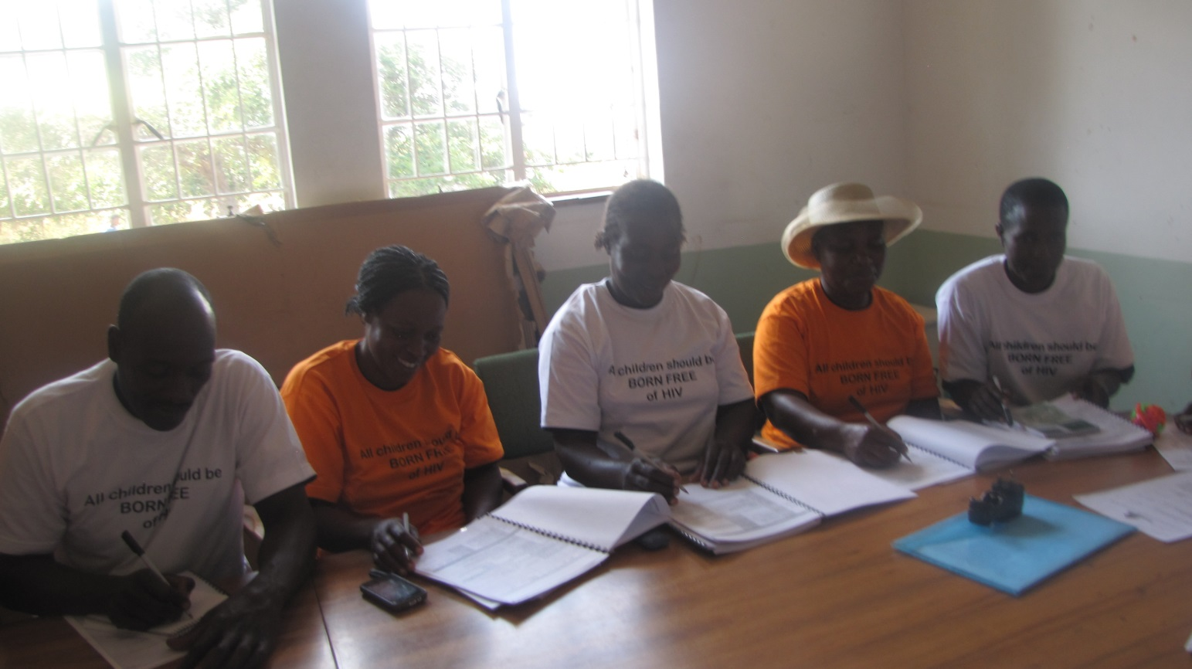
PROCEDURES
PHASE II: Community Tracing (March – May 2015)
Random selection women with no EID traced
Village Health Workers at selected sites trained in tracking methodology and PMTCT by OPHID and MOHCC
Household-level tracing of women by VHWs
Structured questionnaire collected data on:
  Patient characteristics
  Health service uptake
  Reasons for non-use of services
  Process data on tracking
VHWs being trained in LTFU methods
Notes:
**DONE**Title this: “field tracing” or something like that?
**OK Yes out BUT WON’T INCLUDE PROCESS AS NO TIME** The numbers for example the 197 could be presented in the process outcomes of the results instead OK DONE
**YES SEE NEXT SLIDE TO RUN THROUGH BRIEFLY**Something very brief about analysis
Analysis
We calculated the proportion of women without documented EID who reported HIV testing
We tabulated reasons for non-testing in those who did not test.

Slide 8
RESULTS
PHASE I: Register Tracing
Objective 1:
Proportion mother-baby pairs with documented EID

Slide 9
Phase I: Documented uptake EID
Figure 1: Proportion HIV positive women with documented uptake EID
Women in ANC
N = 18 065
HIV Positive ANC
(n=2 651; 14.7%)
Documented EID < 3 months
(n=828; 31.2%)
No documented EID< 3 months
(n=1 823; 68.8%)
Overall, 31.2% (n=828) HIV-exposed infants had documented uptake of EID< 3 months
Notes:
Surprisingly, no difference between proportion known positive and test positive with documented EID

Slide 10
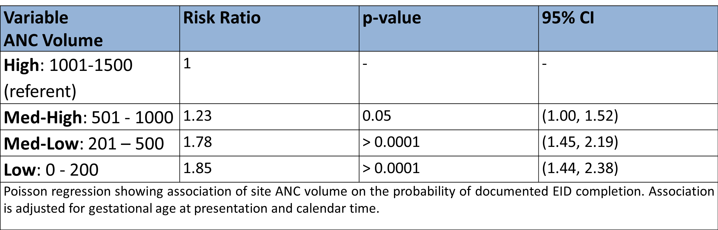
Phase I: Factors associated EID completion
  Earlier gestational age at presentation (Risk Ratio[RR]: 0.97 per two weeks; 95%CI:0.95-0.99; p< 0.01)
  Later calendar time of ANC presentation (RR: 1.04 per 30 days; 95%CI:1.02-1.06, p< 0.01)*proxy of PMTCT program maturity
  Smaller site volume (Table)
Table 1: Documented EID Completion
Webb et al IAS 2015
Notes:
this is among those with documented eid - but you haven’t said in the methods you would do this analysis….
**Good point put it in the analysis slide – really just going to breeze through these and say we have reported previously

Slide 11
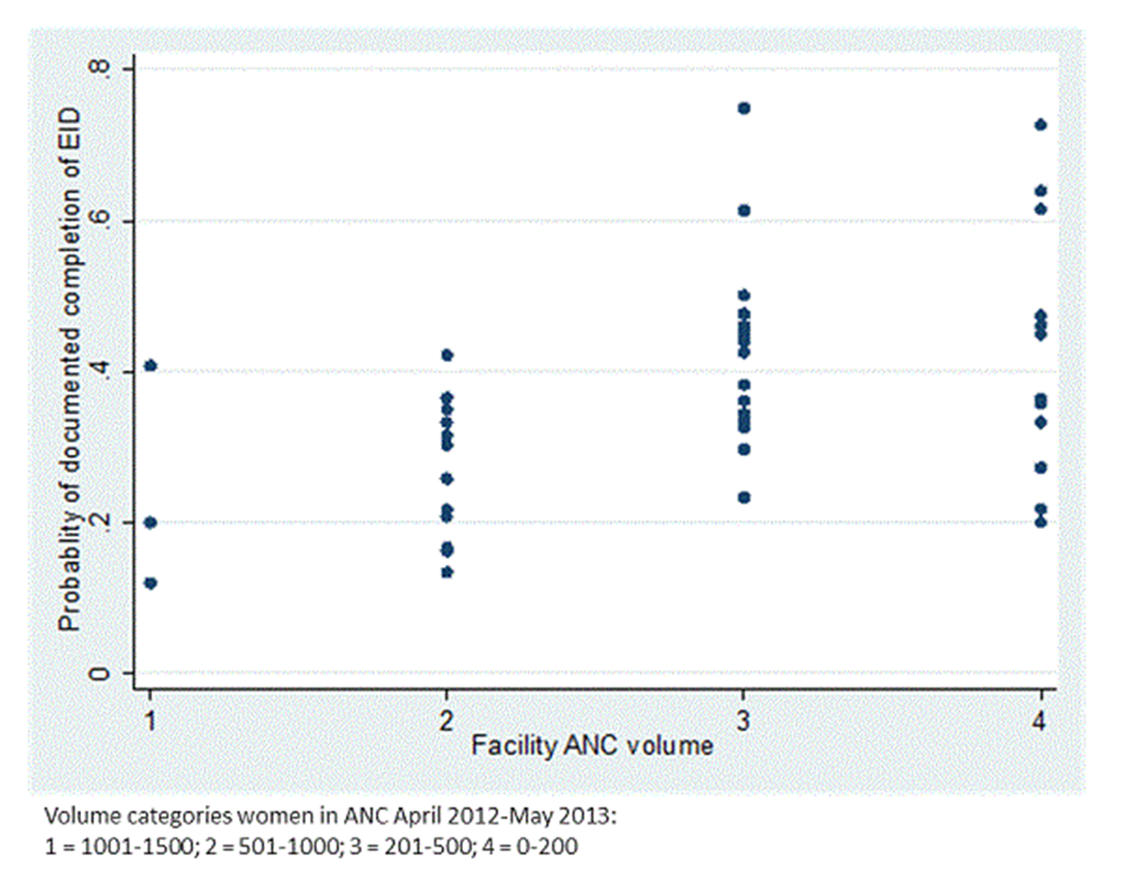
Phase I: EID by ANC site volume
Figure 2: Probability of documented EID completion by patient volume in ANC
Notes:
Brush on this, just to say that documented EID (not true outcomes was demonstrated to vary by volume,

Slide 12
Phase I: How is our Timely EID completion rate looking?
Notes:
-Not good if we only use register data.
-Makes it look like values worse than national - like less than 1/3 access timely
-Estimated completion of EID decreases by 13.8% decrease from nationally reported data.

Slide 13
RESULTS
PHASE II: Community Tracing
Objective 2:
True EID status among those with no documented EID

Slide 14
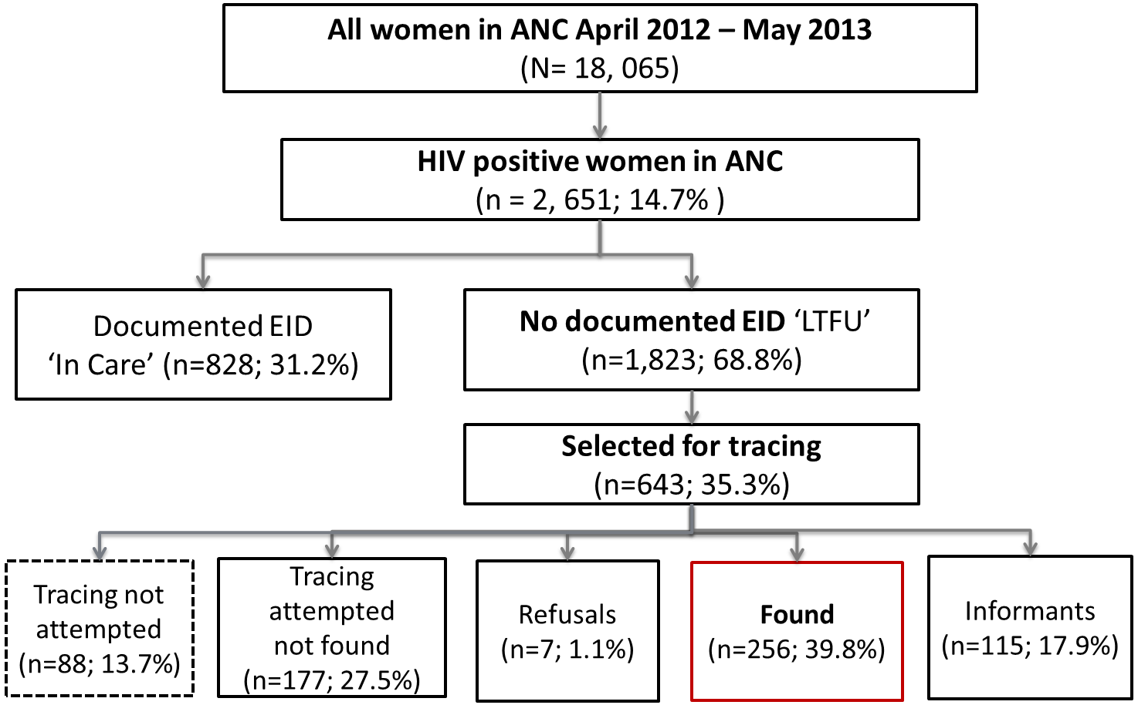
Figure 3. Tracing outcomes LTFU for EID group
Notes:
Key points
#1 almost 1/3 of women could not be located: Locator information not complete enough, Site found residence not found , Patient not known at site
#2 Overall we ascertained true outcomes for 14% of the entire sample with no documented EID (256/1823)
**DONE**This slide is critical – I would put tracing not attempted as a side box, I also don’t understand what “traced” is (you mean found in person?)

Slide 15
Figure 4. Vital status outcomes mother-baby pairs traced
LTFU Tracing attempted
(n=555)
Vital status information; (n=371; 66.8%)
Infant died
(n=66; 17.7%)
*42 timing known
Mother died (n=18; 4.9%)
Mother alive (n=353; 95.1%)
Infant alive (n=305; 82.3%)
Infant died
(n=65;17.4%)
Miscarriage/stillbirth
(n=8; 19.1%)
Birth-90 days
(n=18; 42.9%)
90+ days
(n=16; 38.1%)
Poster THUPDC057 ICASA 2015
Notes:
Important to look at this prior to EID completion to get a picture of infant mortality among HIV-exposed infants
Overall - Almost 2/10 infants traced were deceased - This in contrast to infant mortality rate for the province of 39 per 1000 live births
Overall – majority of infant deaths occurred between birth and 90 days

Slide 16
Figure 4. Early Infant Diagnosis among HIV positive mothers traced
Mothers Interviewed
(n=256)
Infant received EID
(n=190; 76.9%)
Infant received EID
(n=190; 74.2%)
No EID
(n=66; 25.8%)
Timely EID
< 3 months (n=73; 38.4%)
Test date not known
(n=55; 28.9%)
Late EID
> 3 months (n=46; 24.2%)
Infant alive
(n=35; 61.4%)
Infant died
(n=22; 38.6%)
Almost ¾ mothers traced- infant received EID
However, only 38.4% had timely EID
28.9% of mothers did not know when EID was done
Notes:
While majority indicated that they had timely EID, only 38.4% could provide a test date of less than 3 months,
With a large proportion of those with a unknown test date.

Slide 17
Phase II: Recalibrated Timely EID Completion
Notes:
If we account for mothers found, recalibrated EID timely EID completion looks like 57.6%

Slide 18
Phase II: Recalibrated Timely EID Completion
Tracing sample of HIV positive mothers with no documented EID indicates range of timely EID: 57.6% - 76.9%
Notes:
You could use the 30% with no known dates as a sensitivity analysis of sorts – so that you think real eid is X to Y dependng on how you classify those people with unknown dates but were known to have tested. I think back of the envelope is probably OK here but this is what wendy is trying to estimate formally. You also won’t have confidence intervals –
**Yes good idea – see again, will comment that based on our findings timely EID completion could range from 57.6% to upwards of 76.9%!

Slide 19
RESULTS
PHASE II: LTFU Tracing
Objective 3:
Reasons no EID

Slide 20
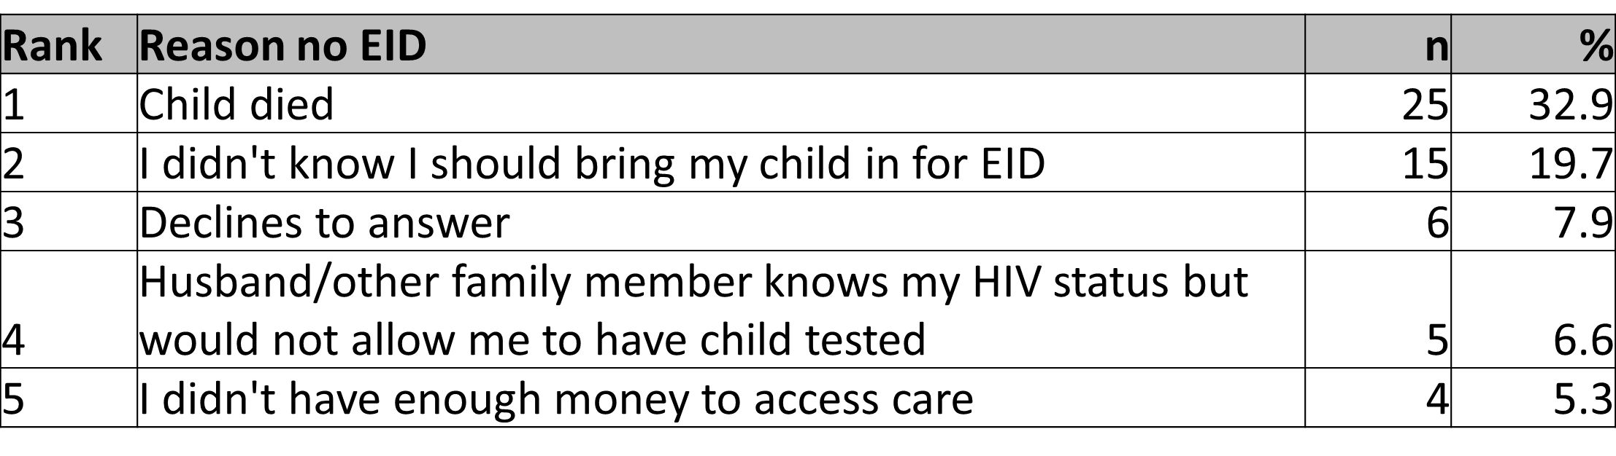
Why no EID?
Table 3. Top 5 reasons for no EID among HIV-exposed infants (N=76)
Table 3. Top 5 reasons for no EID among HIV-exposed infants (N=76)
Poster THUPDD176 ICASA 2015
Notes:
Number one reason for no EID is child died before 3 months of age.

Slide 21
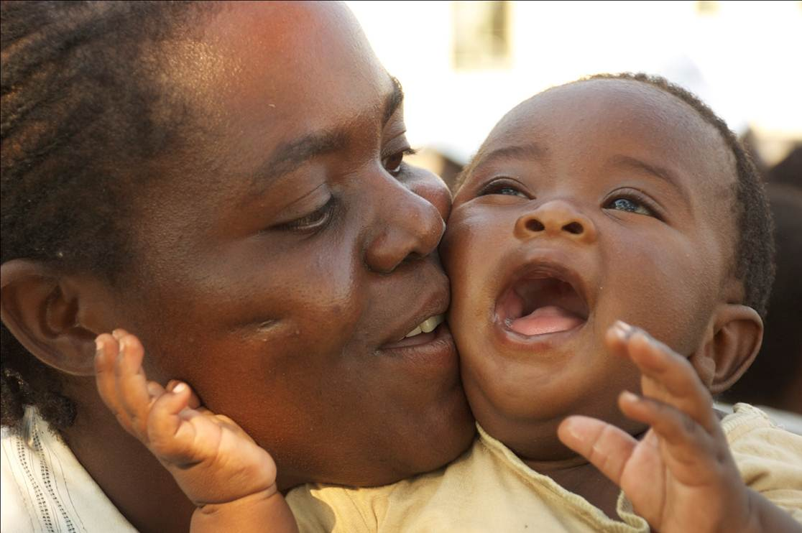
DISCUSSION
EID rates under-estimated by facility registers
…but some major caveats

Slide 22
DISCUSSION
High infant mortality
Late EID in ¼= missed opportunities
“I didn’t know” in no EID group
Where and who are the untraceable?
Notes:
High infant mortality: many HIV-exposed infants don’t survive pregnancy and/or first 3 months of life
Late EID among 24% – missing key opportunities for intervention
Reasons for no EID among living cause for concern – “I didn’t know”
What about all the mothers and infants who were untraceable?

Slide 23
Conclusions
Underestimation of true proportion of HIV-exposed infants receiving timely EID
High mortality among HIV-exposed infants = urgency to identify risk factors for both mortality and failure to uptake timely EID among HIV positive pregnant women
Huge and discrepant range in EID values by source indicates urgent need to strengthen health information systems for reporting outcomes
Value of sampling-based approaches to provide better picture of PMTCT program effectiveness
Notes:
Mention mother-baby pair register currently in development by MOHCC

Slide 24




Thank You – Tatenda – Siyabonga
Ministry of Health and Child Care
President’s Emergency Plan for AIDS Relief (PEPFAR) through USAID and Families and Communities for Elimination of Pediatric HIV in Zimbabwe (AID-613-A-12-00003, FACE Pediatric HIV)
Dr. Elvin Geng, USCF
Health care workers and Village Health Workers at participating sites
HIV positive mothers who participated in the study
FACE pediatric HIV:
Towards elimination of new HIV infections in Zimbabwe

