Slide 1
PRACTICAL STEPS TO IMPLEMENTATION OF SRH AND HIV LINKAGES The Role of Government The Kingdom of Swaziland Experience
Presented by Rejoice Nkambule
Deputy Director of Health Service(Public Health)
@ ICASA Workshop on SRH and HIV integration. Harare .Zimbabwe.
2nd December 2015

Slide 2
Outline
Back ground
Models of SRH/HIV integration
Achievements
Opportunities
Challenges
Lessons learnt

Slide 3
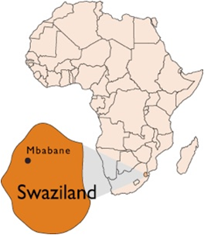
Kingdom of Swaziland
Southern Africa
Landlocked - RSA and Mozambique East.
Population – 1.2 million
52% Population<20yrs
79% lives in rural areas

Slide 4
Health Profile highlights
Organization of Health sector based on PHC strategy and concept( 1983 Health Policy)
Health Policy revised 2007 (PHC key strategy)
Kingdom has >30 years of PHC implementation
EPI coverage – 88% (EPI survey 2014)
IMR – 50 per 1000 live births (MICS2014)
MMR – 310/100 000
HIV Prevalence (15 – 49yrs) – 27% (HIV estimates 2015)
HIV Prevalence among ANC – 35% (Routine ANC 2014)
TB/HIV co infection high at 73% (TB annual report 2014)
Notes:
Planning, Coordinating and implementing institutions and structures were set up for delivery of PHC at national and regional levels:
Decentralization of services
Intersectoral collaboration
Community participation
Existence formed conducive platform and solid foundation for delivering HIV and AIDS interventions.

Slide 5
Delivering Integrated HIV and SRH Services in Swaziland
PHC strategy implementation = foundation
Integrated service delivery package
Government procurement of Essential medicines( including ARVs and TB drugs) and vaccines
Decentralized Health management and services
Community participation and engagement
HIV and SRH integration – relevant entry point
social and economic inequities that make women and girls vulnerable to HIV infection also increase their risk for poor reproductive health outcomes
Achieving MDG 4, 5 and 6 and goals beyond 2015

Slide 6
SRH-HIV INTEGRATION Approaches
1. Integration of HIV services into SRH services
2. Integration of SRH services into HIV services
SRH
HTC
ART
Condoms
ART
FP
STI

Slide 7
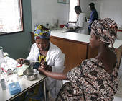
Model 1 – Integrating HIV into SRH(MNCH) – PMTCT 2003 PHC facilities/ Public Health Units/ Health Centres/ hospitals
HIV prevention
ART
Pregnant mothers
PIHTC
HIV Services in Post delivery care
PNC- 6 weeks
EID
HIV into Child welfare schedule
Paediatric ART

Slide 8
ART Integration in MNCH services (SADC best practice)
Mothers and babies get ART until the child is 2yrs old (under one roof)
Nurse led ART initiation at MNCH
Life long ART initiation of pregnant and lactating mothers
Treatment of mother baby pair
Has increased pediatrics ART uptake
Harmonized appointments
Improved retention for the pair

Slide 9
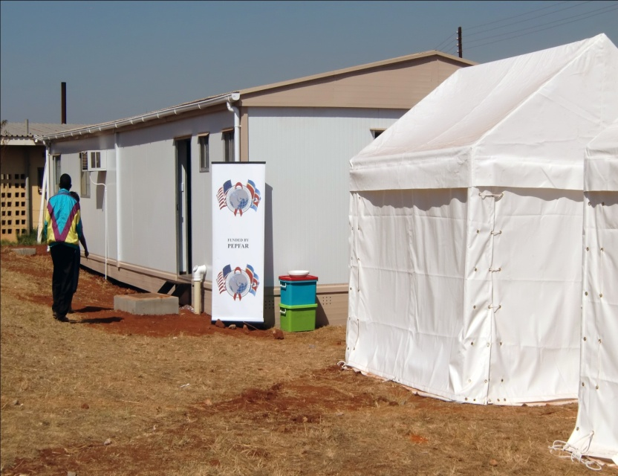
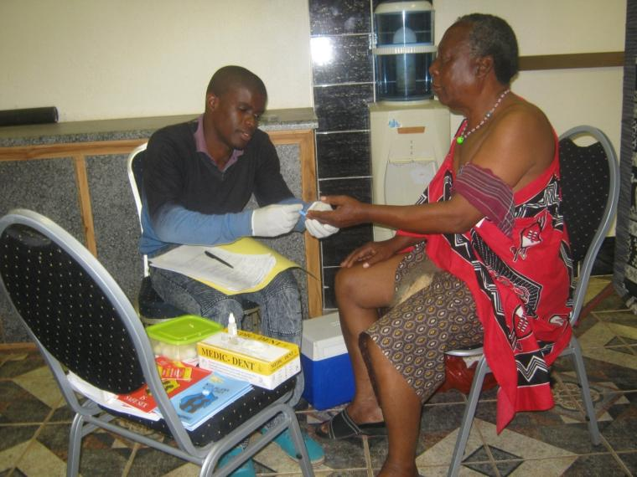
Model 2: Integrating HIV to SRH - VMMC 2009 ( Men’s health clinic, Health centers, hospitals)
Condoms
Male Circumcision
PIHTC
Notes:
As more countries scale up voluntary medical male circumcision, the need to integrate HIV testing and counselling has increased. This has become an opportunity to provide HTC services to the men, who often do not come to the clinic because of societal norms. VMMC has also provided the opportunity to provide condom education and supply, which are accessible because of the location of the MC facilities within the community clinics.

Slide 10
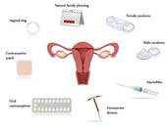
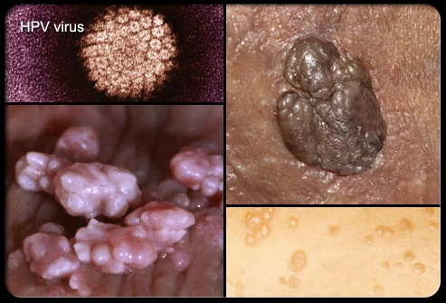
Model 3: Integrating SRH services into HIV/AIDS services- 2012
FP counselling and services
VCT/ART clinic
STI screening and treatment
Condom education/supply
Notes:
In 2010, Swaziland’s National ART Programme agreed on a new approach to providing care and treatment services for PLHIV. This was termed the “Comprehensive Care Package”, which among other things, highlighted the provision of sexual and reproductive health services at the same site where PLHIV access care and treatment services. The minimum package aimed at providing at least one hormonal contraceptive such as the injecatable Depo Provera on site when women of reproductive age come in for re-fills of ARVs. This would be done in a systematic way that ensured that every woman of reproductive age is screened for pregnancy by asking for the LNMP, then offering FP services in needed. Of course, the availability of the simple pregnancy test became a necessity. This approach has not yet been implemented, due to the development and now finalization of the SOPs for integration of FP services within the ART clinics. Others services integrated include diagnosis and treatment of STIs

Slide 11
ACHIEVEMENTS (highlights)
Achievements (Dec 2014)
National targets
PMTCT ARV coverage-95%(MICS 2015)
Increase in Infants born HIV free 78% in 2006 to 94.6% in 2015 (18-24 Months study 2014)
ART- 68%
Adults-76%
Peadiatrics-54%
HTC uptake in VMMC-97%(HIV annual report 2014)
Incidence decline(from 3% in 2007 to 2.4% in 2015) SHIMS 2012
ARV for PMTCT 90% (2018)
Reduction in incidence to 1.3% by 2018
Universal ART coverage 80% by 2018

Slide 12
Opportunities for universal Coverage in HIV/SRH integrated services
Health remains a government priority even in context of fiscal adjustments.
Redefined Essential Health Care Package based on PHC approach and EML
Availability of Global and Regional Health initiatives eg PEPFAR, GF, Integra, EU/UNFPA, SIDA and UNAIDS regional project on integration
Sustained support from Multi-Laterals partners eg WHO, UNICEF, UNFPA

Slide 13
Challenges
Infrastructure does not always accommodate the added services
There is a high demand on HCW skills leading to burn out
Integration is difficult to compare between levels of care and countries

Slide 14
Lessons learnt
Lesson | Evidence in the Kingdom experience
Sustained political commitment is fundamental | Government procurement of Essential medicines, ARVs, sexual and reproductive health commodities and laboratory reagents
2. Clear and documented policies and guiding documents are key | National strategic documents and Guidelines eg SRH Policy, HIV Policy, Treatment guidelines, Job aides etc

Slide 15
Lessons learnt
Lesson | Evidence in the Kingdom experience
3. Clear management and coordination structures, maintains focus on desired goal | Government play leading role and coordinates all stakeholders eg 1 national TWG for treatment and care led by MOH,
4. Models of service delivery must build on existing structures (HSS) | PHC – remains a relevant strategy to achieve universal coverage of integrated services

Slide 16
Lessons learnt
Lesson | Evidence in the Kingdom experience
5. Community engagement is a continuous challenge requiring continuous innovative strategies | National TWG for Community health has been established.
6. Monitoring and evaluation is a crucial element for accountability and key to quality improvement | National annual progress reports Data reviews meeting at national(NASAR) and regional levels.

Slide 17
HIV&SRH INTEGRATION
Notes:
A Key lesson that we have learnt and have concluded that it is the recipe for success is shown on this schematic diagram. With a clear map, a developed road and government on the driver’s seat, we maximise the use of available support to achieve the common stipulated goal. This is what prevails in the Kingdom and we are committed to improving it for us to achieve Elimination new HIV infections among children by 2015 and keeping their mothers alive. We believe it and we are doing it. I thank you.

Slide 18
THANK YOU

